Slide 1
Developing an Employee Benefits strategy
theinkgroup.co.uk
Version: 02
04/2021

Slide 2
What is your Employee Value Proposition?
“What you expect from your employees and what you will give them in return”

Slide 3
Employee Value Proposition (EVP)
Defines the “employment deal”
Asks the fundamental questions
Makes you focus on…
What you expect from your employees and what you’ll give in return
Who are we as an organisation?
What are our values?
What do we do?
Why does it matter?
What workforce do we need?
What matters to them?
With whom do we compete for talent?
How do we attract talent?
How do we retain talent?
People & Relationships
Quality & Nature of Work
Culture & Environment
Opportunities for Personal Growth
Reward & Recognition

Slide 4
Employee Value Proposition (EVP)
Reward & Recognition
We break this down further into:
Pay
Employee Benefits
Wellbeing
Recognition
Reward & Recognition
Culture & Environment
Quality & Nature of Work
People & Relationships
Opportunities for Personal Growth

Slide 5
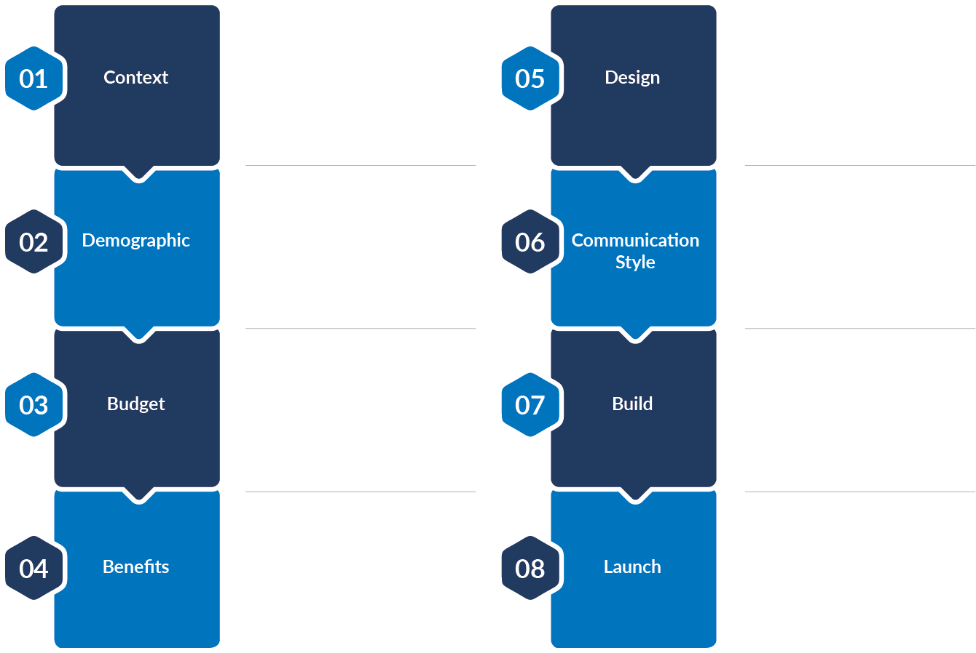
Shaping your post TPS Employee Benefits strategy – our golden rules.
Where do Employee Benefits sit in your EVP?
How will these benefits be delivered?
Who do you employ?
How will you engage your employees with these benefits?
What is your annual benefits budget?
What is your timescale and what do you need to do?
What benefits would you ideally like to put in place?
When do you want to go live?

Slide 6
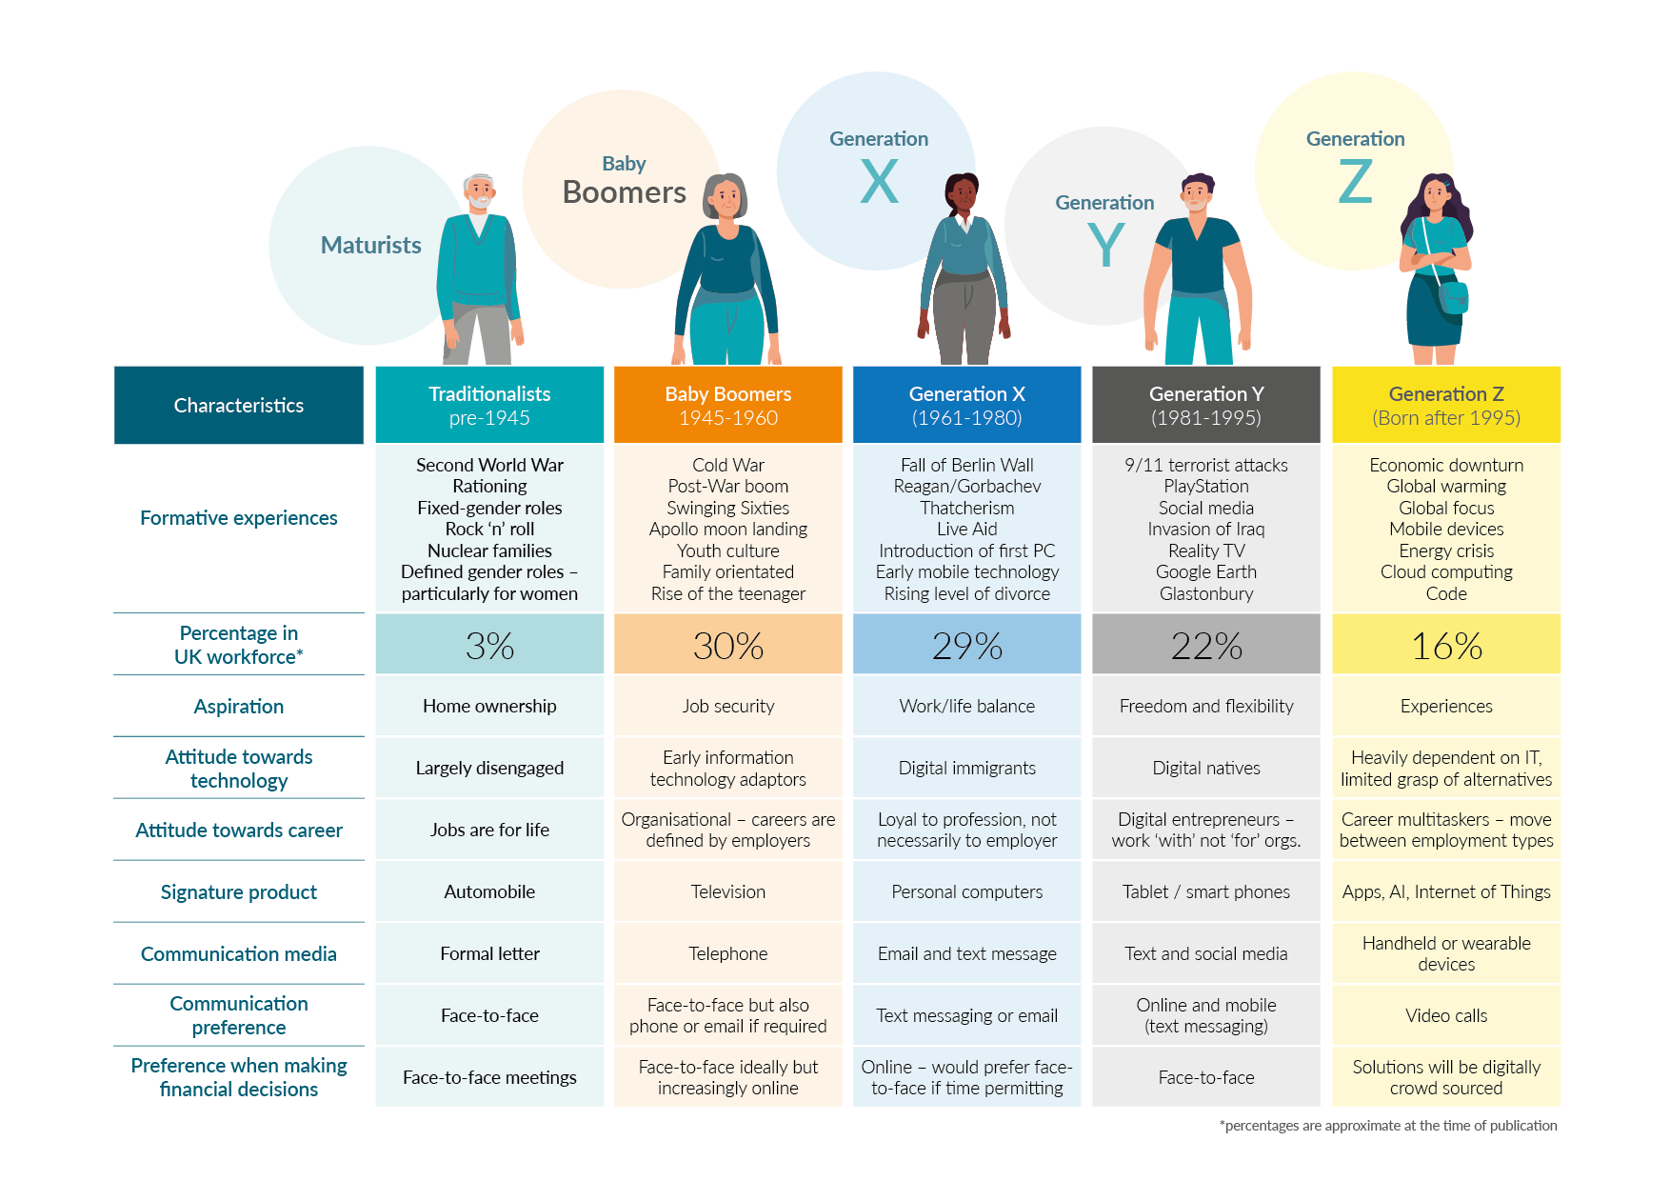
An overview of the working generations.

Slide 7
Where are your Employee Benefits priorities?
Long Term Incentives
Group Life Assurance
Group Income Protection
Group Critical Illness
Private Medical Insurance
Financial Education & Guidance
Occupational Sick Pay
Health Cash Plan
Group Dental Insurance
Employee Health Checks / Medicals
Total Reward Statements
Employee Assistance Programme
Exams & Course fees
Childcare Vouchers
Ride to Work
Flexible Working
Holiday above Statutory
Retail Vouchers
Staff discounts
Eldercare
Sabbaticals
Wellness Programmes
Debt management
Pension

Slide 8
Different strategies for the working generations?
REWARD STRATEGY FOR ‘BABY BOOMERS AND GEN X’
Focus tends to be on financial security, retirement and protection in the event of negative events (death, illness, redundancy etc)
REWARD STRATEGY FOR ‘GEN Y AND MILLENIALS’
Company Paid
Company Paid
Financial Wellbeing
Voluntary
Financial Wellbeing
Voluntary
Lifestyle
Protection
Lifestyle
Protection
Focus tends to be on lifestyle related benefits that are about the “here and now”. Any preventative benefits are linked to the ability to continue to earn money
Health and Wellbeing
Health and Wellbeing

Slide 9
Our range of Employee Benefits…

Slide 10
Who pays for what?
“Benefits can be paid for in full by the employer, in part with an employee top-up, or wholly by the employee”
Core (Company Paid)
Voluntary or Top-up (Employee Paid)
Flexible (Trading the value benefits)

Slide 11
How will you communicate your benefits to employees?
Employment documents (Contracts, Policies & Handbooks)
Basic electronic (intranet, pdfs etc)
Online Portal
Face to face
Basic
Static
Employee Benefits Booklet
Employee Benefits booklet
Branded and completed in company look and feel
Printed media (posters, leaflets etc)
Presentations
Workshops
1:1 meetings
Cloud based
Total Reward Statement
Individual login
Company branded
Flexible benefits

Slide 12
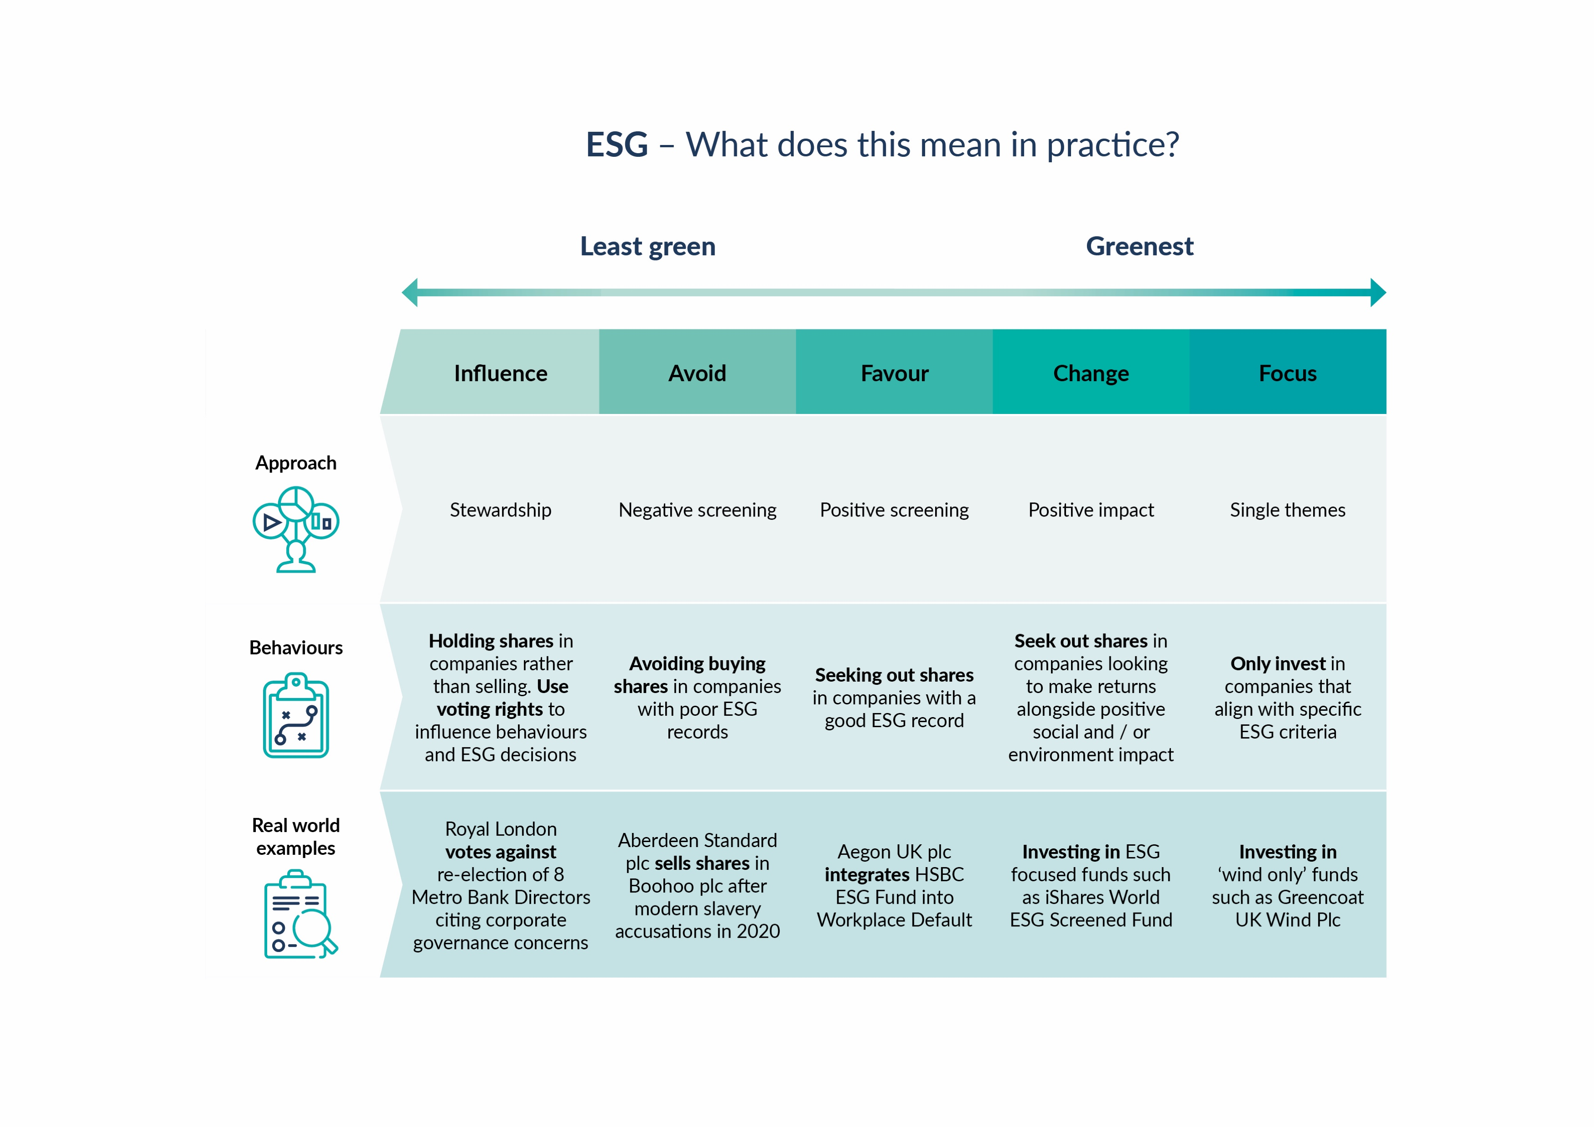

Slide 13
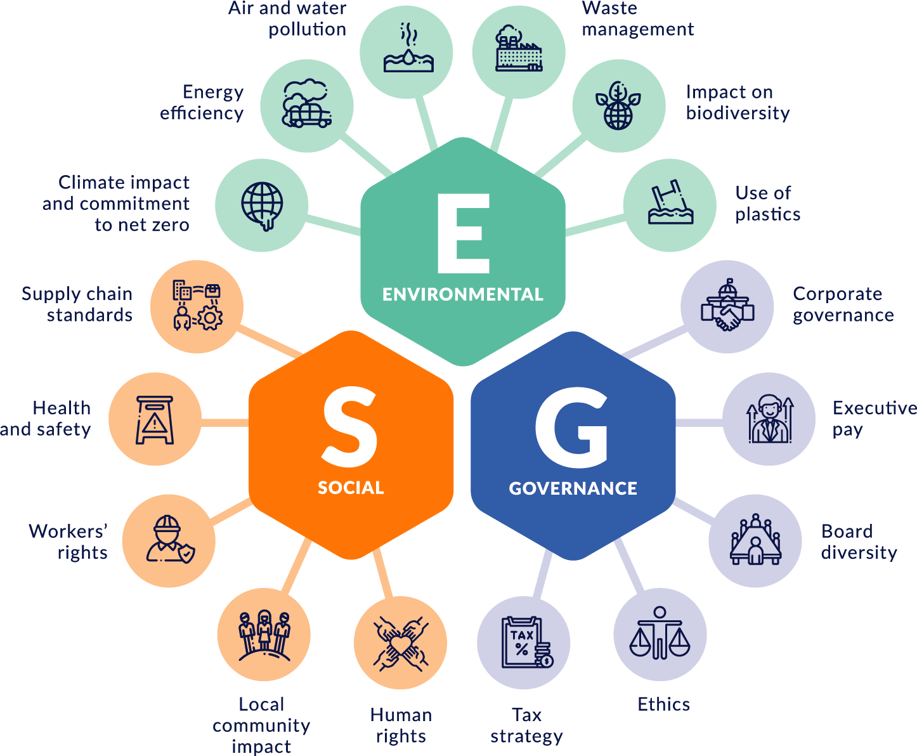
Environmental, Social and Governance (ESG) investing
ESG investing is about understanding the impact of potential companies we might invest in across three broad areas:

Slide 14
If you would like to discuss our services in more detail, please contact any of our TPS advisory team members:
William Johnson Managing Director 07808 876253 william.johnson@theinkgroup.co.uk
Sarah Simpkins Account Director – HR 07725 736185 sarah.simpkings@theinkgroup.co.uk
Angela Ward Account Director – Employee Benefits 07715 659641 angela.ward@theinkgroup.co.uk
theinkgroup.co.uk
The Ink Group is a trading style of Ink Employee Benefits Limited and Ink HR Limited. Ink Employee Benefits Limited is authorised and regulated by the Financial Conduct Authority (FCA 609071)

